Slide 1
Point and line

Slide 2
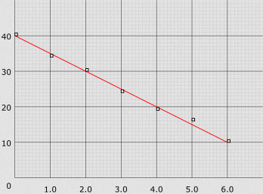
What is a Line
A line connects two points. It is a basic element in graphics.
To draw a line, you need two points between which you can draw a line.

Slide 3
Line Properties
Wide Lines
void glLineWidth(float width); use to control the size of the line
Two vertex need to create one line (start point & end point).
We bracket each set of vertices between a call to glBegin() and a call to glEnd().

Slide 4
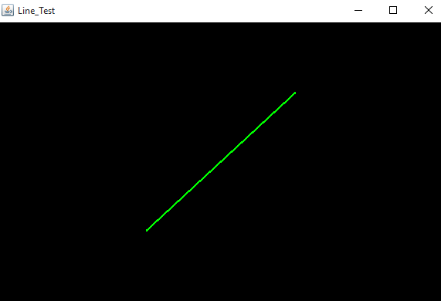
Line Example
100,100
gl.glColor3f(0.0f,1.0f,0.0f);
gl.glLineWidth(3.0f);
gl.glBegin(GL2.GL_LINES);
gl.glVertex2i(-100,-100);
gl.glVertex2i(100,100);
gl.glEnd();
-100,-100

Slide 5
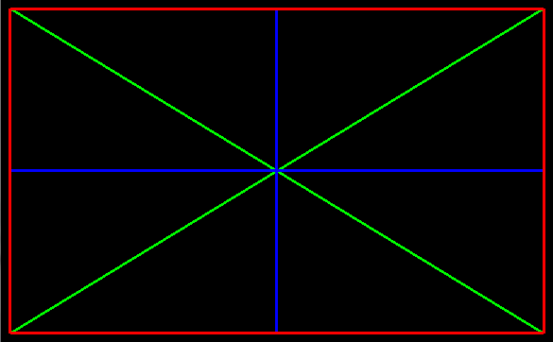
Class Activity (1)

Slide 6
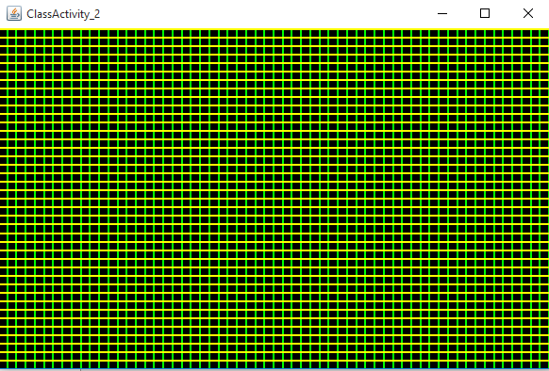
Class Activity 2
By Using only Two Lines

Slide 7
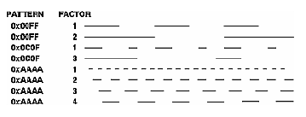
Line Stipple

Slide 8
Line Stipple(cont.)
void glLineStipple(int factor, short pattern);
The pattern is a 16-bit series of 0s and 1s.
1 indicates that drawing occurs, and 0 that it does not.
The pattern can be stretched out by using factor.
factor is lie between 1 and 255
enabled by passing GL_LINE_STIPPLE to glEnable(), and disabled by glDisable()
If the pattern 0x3F07 (0011111100000111 in binary), a line would be 3 pixels on, then 5 off, 6 on, and 2 off
If factor = 2, the pattern would have been: 6 pixels on, 10 off, 12 on, and 4 off

Slide 9
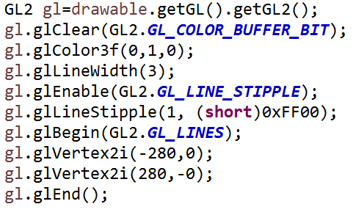
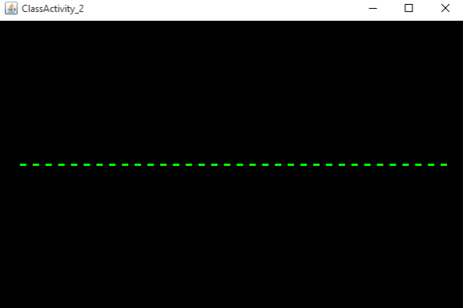
Line Stipple Ex.
1111 1111 0000 0000

Slide 10
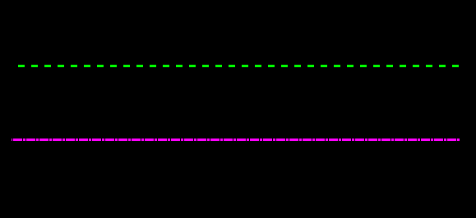
Class Activity 3
Write a program to render the above output, if you know
Factor of first line = FF00
Factor of second line = DFFD

Slide 11
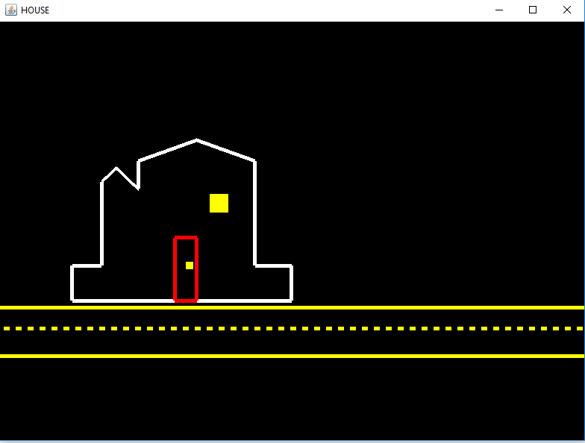
Home Work

